Slide 1

Topic : Spam Mail Classification
RV College of Engineering
Go, change the world
Experiential Learning - Mathematics
(Course code:21MA41)
Aditya -1RV21CS015
D.Navya-1RV21CS039
Khushboo shrivastava-1RV21CS164

Slide 2

Go, change the world
INTRODUCTION
RV College of
Engineering
Now-a-days, communication through email has become one of the cheapest and easy ways for the official and business users due to easy availability of internet access.
Many people misuse this easy way of communication by sending unwanted & useless bulk emails to others.
Spam emails often carry malicious content such as phishing links, malware, and scams. Clicking on these links or downloading attachments can lead to security breaches, data theft, or identity theft.
Spam emails can spread false information, rumors contributing to the dissemination of unreliable information.
Privacy Concerns: Some spam emails might request personal or financial information, tricking users into revealing sensitive details.
So, there is the need of some proper approach that filters the excessive data of emails in the form of spam emails.

Slide 3
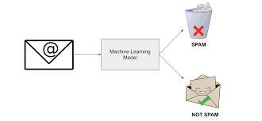
Go, change the world
Approach
RV College of
Engineering
In our project, we have used the Logistic Regression Machine learning algorithm for classification of the mails into spam and ham mails .
The main aim of our project was to detect spam mails accurately. For this, we have taken the Mail Spam Collection Dataset from Kaggle.com.
This dataset contains 5574 mails with Ham and spam mails
There are 5574 mails in the dataset, out of which 4825 mails are not spam and 747 are spam mails.

Slide 4
Go, change the world
What is Logistic Regression
RV College of
Engineering
Logistic regression is a supervised machine learning algorithm mainly used for classification tasks where the goal is to predict the probability that an instance belongs to a given class.
It is used for predicting the categorical dependent variable using a given set of independent variables.
Logistic Regression has the ability to provide probabilities and classify new data using continuous and discrete datasets.
In Logistic regression, instead of fitting a regression line, we fit an S shaped logistic function, which predicts two maximum values (0 or 1).

Slide 5
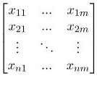
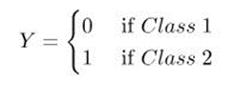

Mathematical understanding
RV College of
Engineering
Go, change the world
Logistic regression model transforms the linear regression function continuous value output into categorical value output using a sigmoid function.
Let the independent input features X=
dependent variable Y=
By, applying the multi-linear regression function to the input variables X
, where wi - weights/ coefficient,
xi – ith observation of X
, Spam class
, Ham class

Slide 6
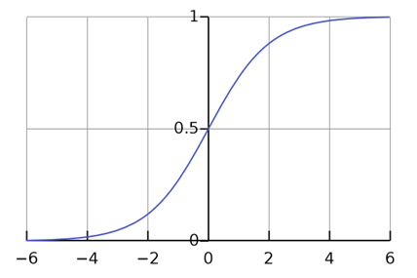
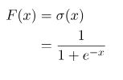
Go, change the world
RV College of
Engineering
Sigmoid function maps any real-valued set of independent variables input into a value between 0 and 1.
Applying sigmoid function to the multi regression equation, we get
Y= F(z)= 1/(1+e^-(w.x+b)), here Y is probability that mail belongs to ham class
If Y>0.5, we will consider Y nearly equals to 1 i.e., classify into Ham mail class
Y<0.5, we will consider Y nearly equals to 0 i.e., classify into Spam mail class

Slide 7
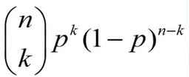
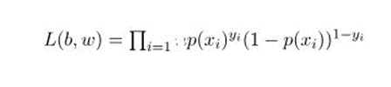
Go, change the world
RV College of
Engineering
Since we have only two possibilities either it might be spam or ham mail we can apply binomial distribution function. Now n=1, because we are making one trial, so nCk term becomes 1 irrespective of k=0 or k=1
Likelihood essentially means finding the parameter values that make the observed outcomes most probable based on the model
Likelihood is calculated as product of all individual probabilities computed by our logistic regression model.
However the likelihood will be very small tending to zero since it is product of probabilities. So we take logarithmic of likelihood

Slide 8
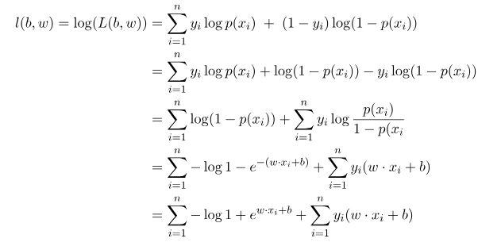
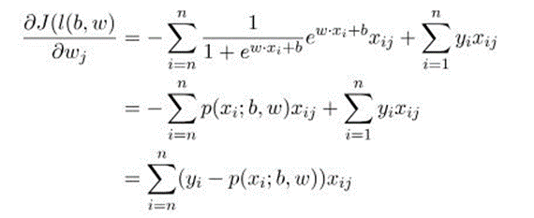
Go, change the world
RV College of
Engineering
To find the maximum likelihood we differentiate the likelihood equation

Slide 9
CODE
RV College of
Engineering
Go, change the world
Libraries' used
import numpy as np
import pandas as pd
from sklearn.model_selection import train_test_split
from sklearn.feature_extraction.text import TfidfVectorizer
from sklearn.linear_model import LogisticRegression
from sklearn.metrics import accuracy_score
# loading the data from csv file to a pandas Dataframe
raw_mail_data = pd.read_csv('/Users/djrrr/Downloads/mail_data.csv')

Slide 10
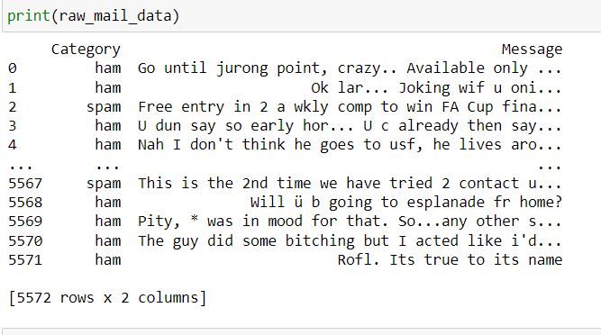
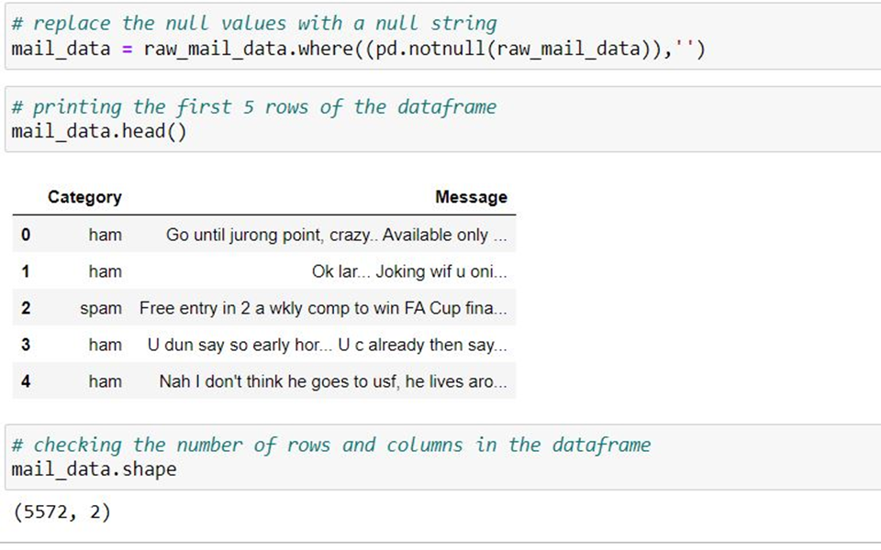
RV College of
Engineering
Go, change the world

Slide 11
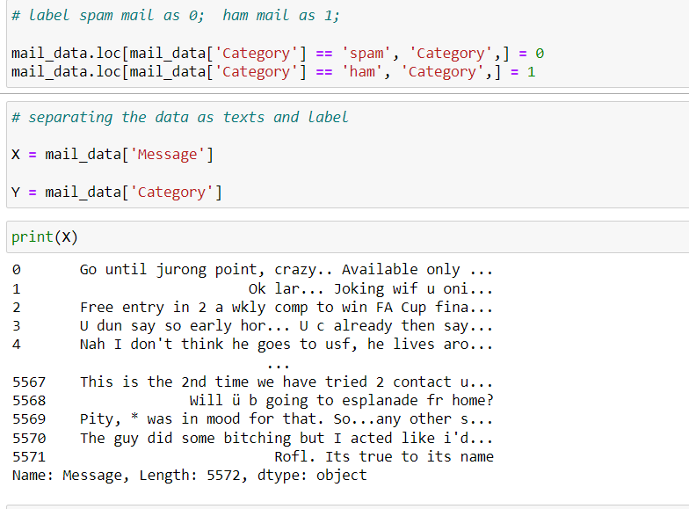
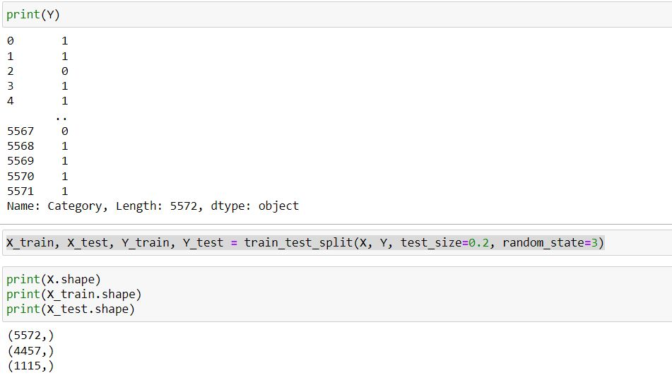
RV College of
Engineering
Go, change the world

Slide 12
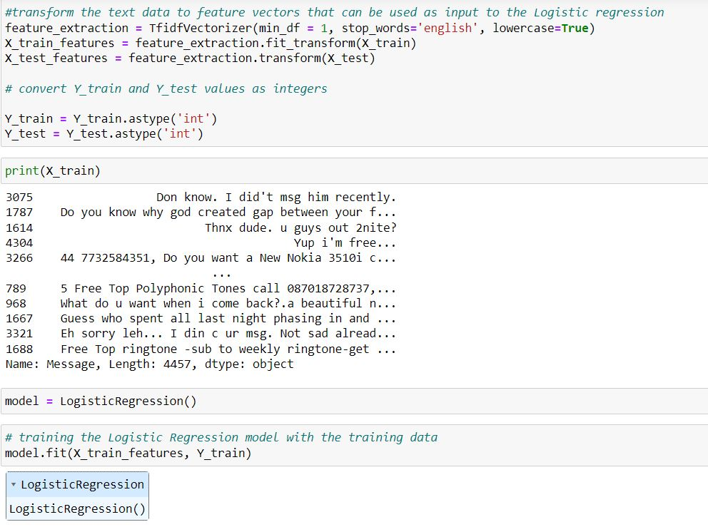
RV College of
Engineering
Go, change the world

Slide 13
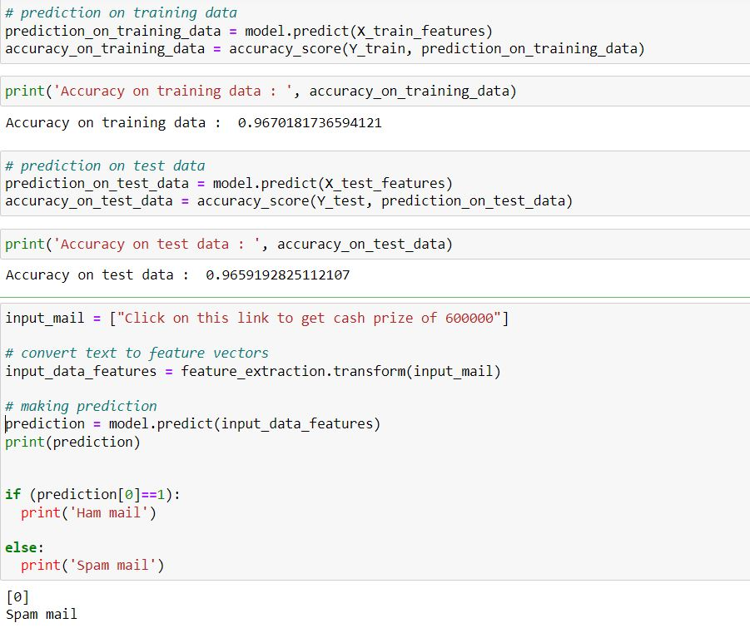
RV College of
Engineering
Go, change the world

Slide 14
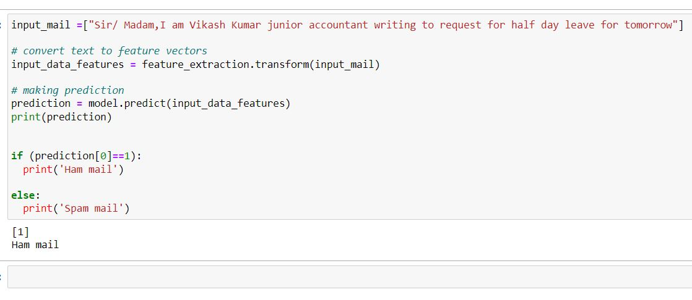
RV College of
Engineering
Go, change the world

Slide 15
Go, change the world
RV College of
Engineering
Literature review
Sl no | Paper Name | Authors | Year of publishing | Inference
1. | Spam Classification Based on Supervised Learning Using Machine Learning Techniques | M. Raja Chakkaravarthi, P. Lakshmi Surya, Karthika Renuka Dhanaraj | July 2011 | The ubiquity of email as a communication medium has led to the rise of e-mail-based threats, notably spam. Spam emails disrupt user experience, strain network resources, and pose financial risks. This study explores various machine learning algorithms, including MLP, and Naive Bayesian, for effective spam classification. Comparative analysis underscores their efficacy in addressing the persistent challenge of email spam.
2. | A Novel Technique of Email Classification for Spam Detection | Vinod Kumar Patidar, Vinod Kumar Patidar, Anju Singh | August 2013 | Email spam remains a pressing issue causing annoyance and financial harm. Filtering, a vital countermeasure, organizes email and targets spam. Given evolving spam tactics, research is crucial. Spam constitutes over 70% of email traffic, impacting companies financially and impeding employee productivity. This study suggests a novel approach: spam classification via Support Vector Machine (SVM), which outperforms other classifiers.

Slide 16
Sl no | Paper Name | Authors | Year of publishing | Inference
1. | Prediction of Spam Email using Machine Learning Classification Algorithm | Srujan kotagiri Raju | June 2021 | Email spam is a pressing issue, with sophisticated techniques evading traditional filters. This study compares various supervised machine learning methods (SVM, Random Forest, Decision Tree, CNN, KNN, MLP, Adaboost, Naïve Bayes) for classifying spam emails. The objective is to develop a model that effectively predicts whether an email is spam or not, based on email content.

Slide 17
Go, change the world
RV College of
Engineering
THANK YOU

